Slide 1

Address
Resolution
Protocol
(ARP)
TCP/IP Protocol Suite
Copyright © The McGraw-Hill Companies, Inc. Permission required for reproduction or display.

Slide 2
OBJECTIVES:
To make a distinction between logical address (IP address) and physical address (MAC address).
To describe how the mapping of a logical address to a physical address can be static or dynamic.
To show how the address resolution protocol (ARP) is used to dynamically map a logical address to a physical address.
To show that the proxy ARP can be used to create a subnetting effect.
To discuss ATMARP, which maps the IP addresses when the underlying network is an ATM WAN.
To show that an ARP software package can be made of five components.
To show the pseudocode for each module used in the ARP software package.
TCP/IP Protocol Suite

Slide 3
Chapter
Outline
8.1 Address Mapping
8.2 The ARP Protocol
8.3 ATM ARP
8.4 ARP Package
TCP/IP Protocol Suite

Slide 4
8-1 ADDRESS MAPPING
The delivery of a packet to a host or a router requires two levels of addressing: logical and physical. We need to be able to map a logical address to its corresponding physical address and vice versa. These can be done using either static or
dynamic mapping.
TCP/IP Protocol Suite

Slide 5
Topics Discussed in the Section
Static Mapping
Dynamic Mapping
TCP/IP Protocol Suite

Slide 6
8-2 ADDRESS MAPPING
Anytime a host or a router has an IP datagram to send to another host or router, it has the logical (IP) address of the receiver. But the IP datagram must be encapsulated in a frame to be able to pass through the physical network. This means that the sender needs the physical address of the receiver. A mapping corresponds a logical address to a physical address. ARP accepts a logical address from the IP protocol, maps the address to the corresponding physical address and pass it to the data link layer.
TCP/IP Protocol Suite

Slide 7
Topics Discussed in the Section
Packet Format
Encapsulation
Operation
Proxy ARP
TCP/IP Protocol Suite

Slide 8
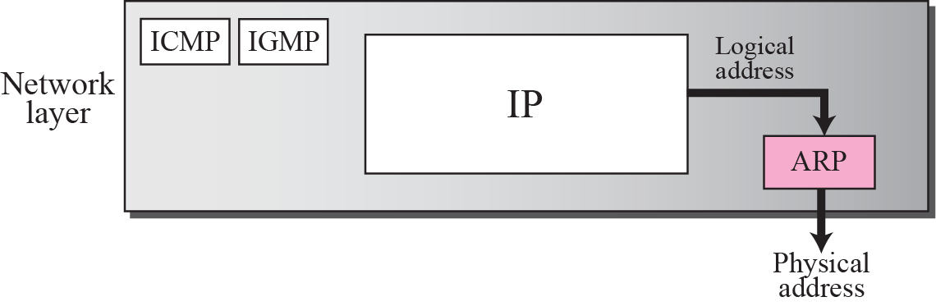
Figure 8.1 Position of ARP in TCP/IP protocol suite
TCP/IP Protocol Suite

Slide 9
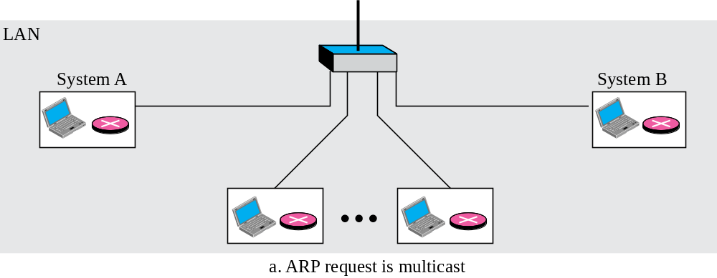
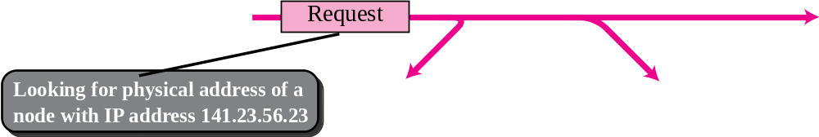
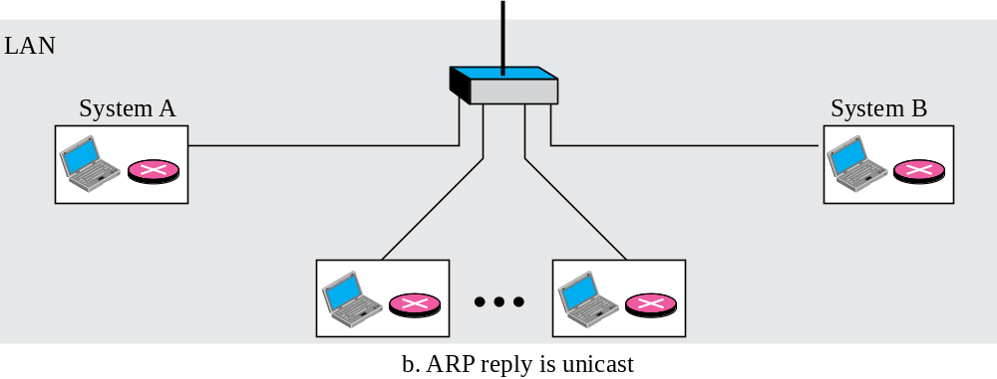
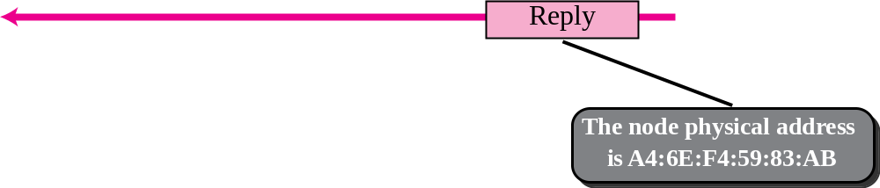
Figure 8.2 ARP operation
TCP/IP Protocol Suite

Slide 10
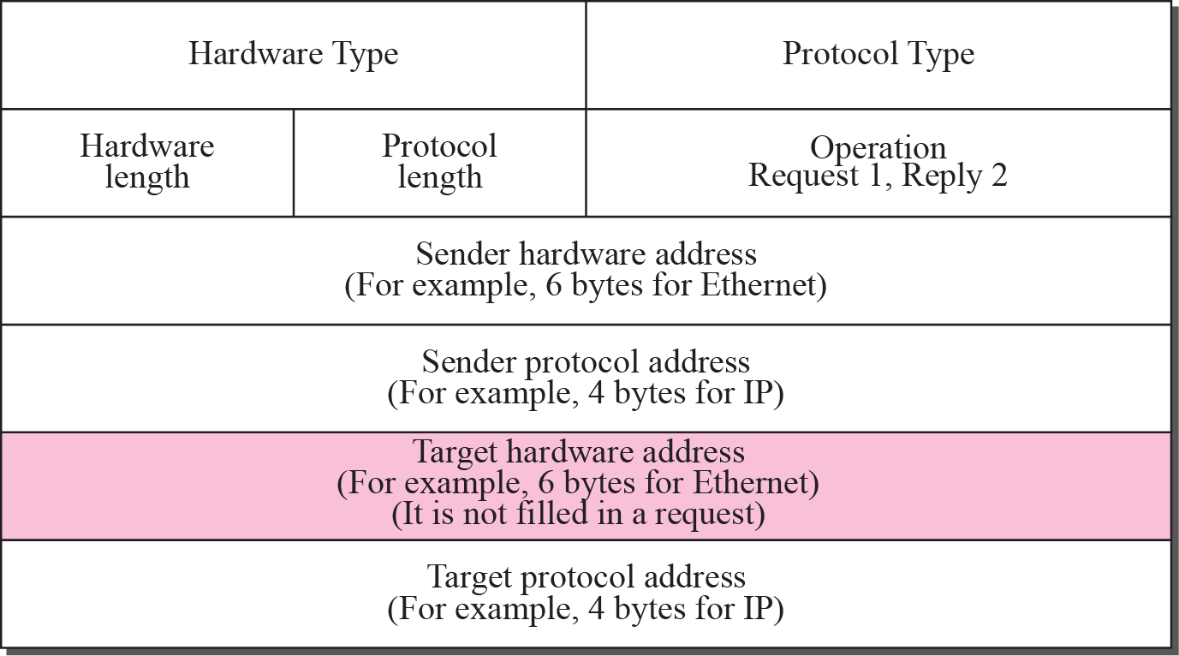
Figure 8.3 ARP packet
TCP/IP Protocol Suite

Slide 11
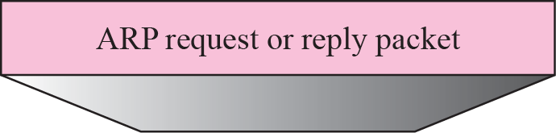
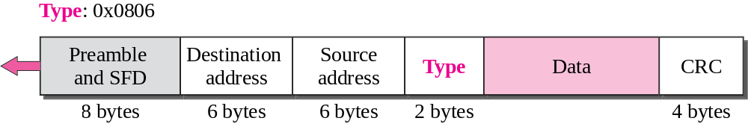
Figure 8.4 Encapsulation of ARP packet
TCP/IP Protocol Suite

Slide 12

Note
An ARP request is broadcast;
an ARP reply is unicast.
TCP/IP Protocol Suite

Slide 13
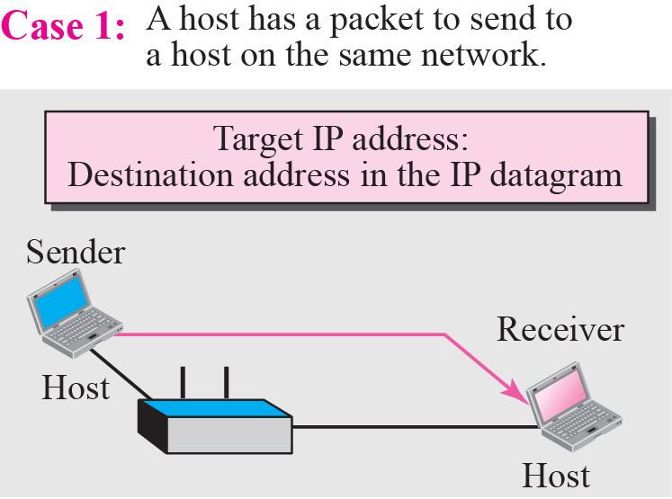
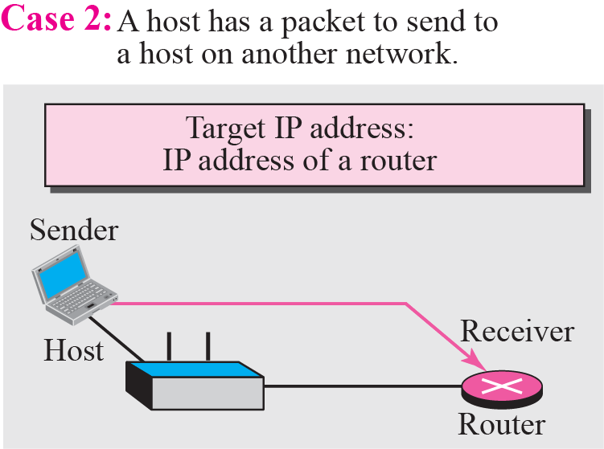
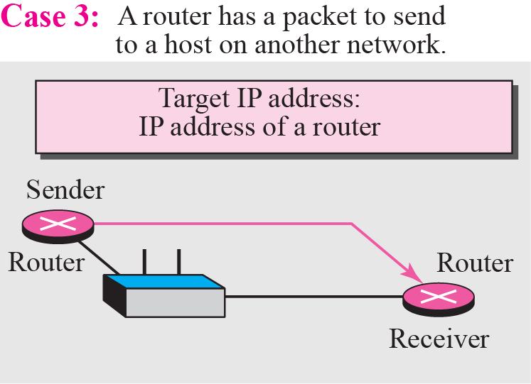
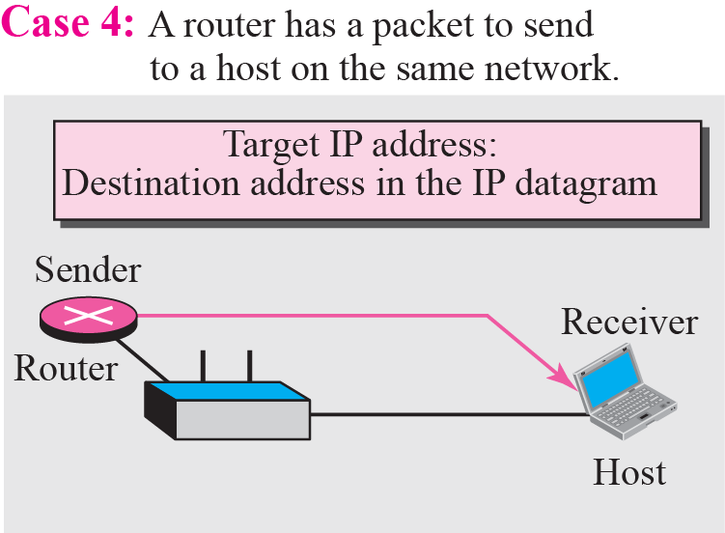
Figure 8.5 Four cases using ARP
TCP/IP Protocol Suite

Slide 14
Example 8.1
A host with IP address 130.23.43.20 and physical address B2:34:55:10:22:10 has a packet to send to another host with IP address 130.23.43.25 and physical address A4:6E:F4:59:83:AB. The two hosts are on the same Ethernet network. Show the ARP request and reply packets encapsulated in Ethernet frames.
Solution
Figure 8.6 shows the ARP request and reply packets. Note that the ARP data field in this case is 28 bytes, and that the individual addresses do not fit in the 4-byte boundary. That is why we do not show the regular 4-byte boundaries for these addresses. Also note that the IP addresses are shown in hexadecimal.
TCP/IP Protocol Suite

Slide 15
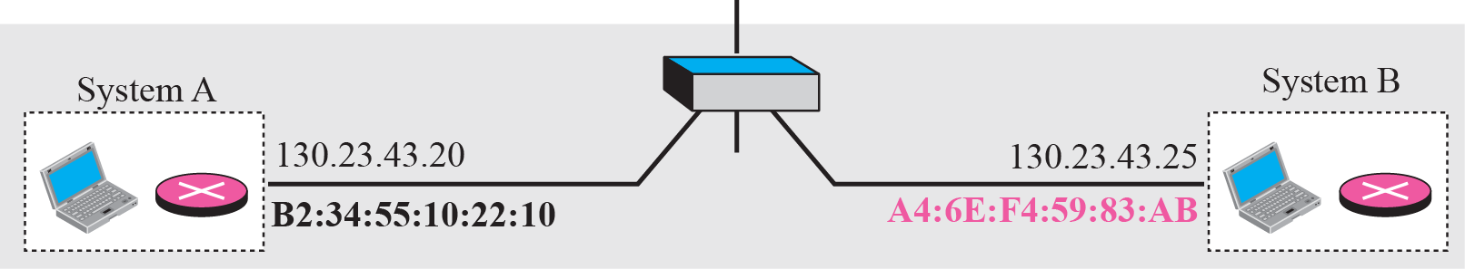
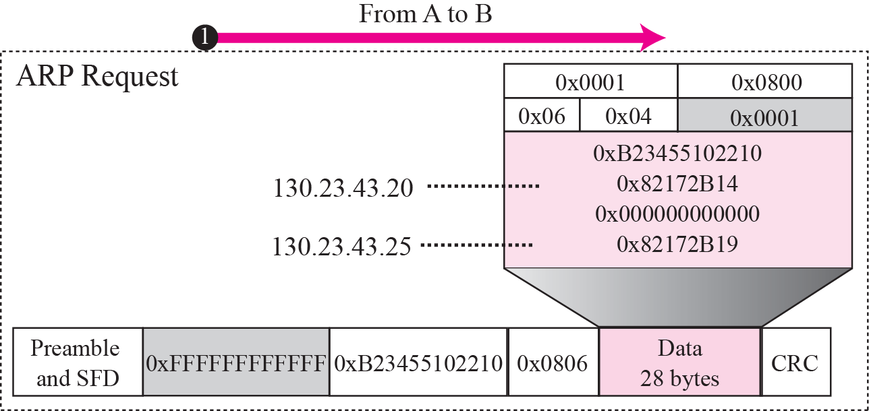
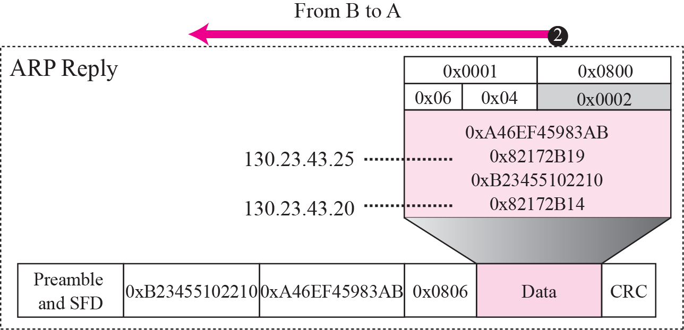
Figure 8.6 Example 8.1
TCP/IP Protocol Suite

Slide 16
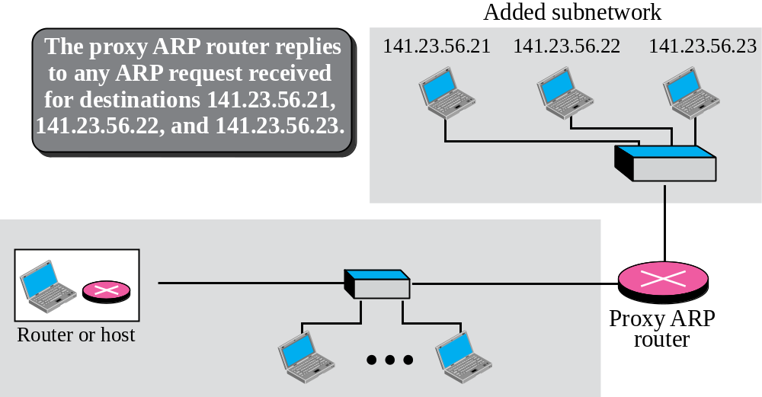
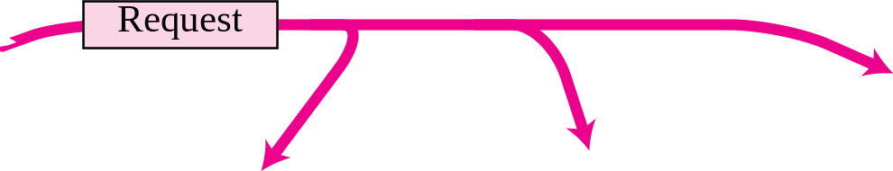
Figure 8.7 Proxy ARP
TCP/IP Protocol Suite

